Slide 1
Notes:
Congratulate new employees on their new positions and thank them for choosing public service.

Slide 2
Notes:
Congratulate new employees on their new positions and thank them for choosing public service.

Slide 3
what exactly is NTEU?
Wait a minute…
Notes:
Wait a minute…What exactly is NTEU?

Slide 4
NTEU is your…
PARTNER
VOICE
ADVOCATE
Notes:
You have an advocate and partner in NTEU. We stand with you throughout your career in the federal government. We are your voice on Capitol Hill.

Slide 5

NTEU
is the largest independent
labor union in the federal government

Slide 6
You might be thinking…
why do I need a union?

Slide 7

The federal government is massive.
Congress, the White House and our agency’s top management set the rules that govern our workplace.
It is tough for one employee to convince all of Congress to provide federal workers with a higher pay raise or establish a new benefit like paid parental leave.

Slide 8

But it’s hard to ignore the collective voices of a large group of employees calling for positive change.
And that is exactly what a union does.
And NTEU is pretty darn good at it.

Slide 9
NTEU has been the driving force behind a long string of workplace rights and benefits including:
  Higher pay raises
  Telework programs
  FMLA
  Transit subsidies
  Paid parental leave
  And lots more

Slide 10
Still not convinced a union is for you?
Are you interested in:
Input into Workplace Decision?
Improved Work-Life Balance?
A Secure Retirement?
Higher
Pay Raises?
Then, NTEU is for you.
Notes:
You may be sitting there thinking, is joining a union for me? Ask yourself these questions.
If you answered “yes” to any of these then yes, NTEU is for you.

Slide 11


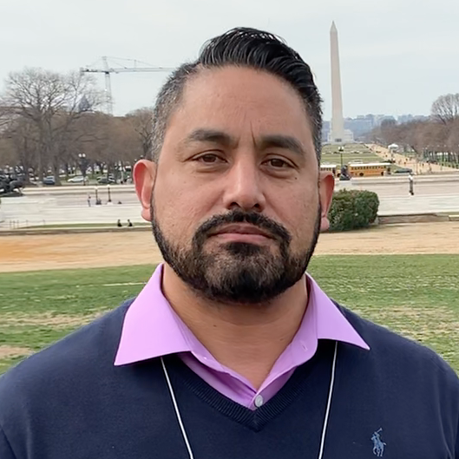

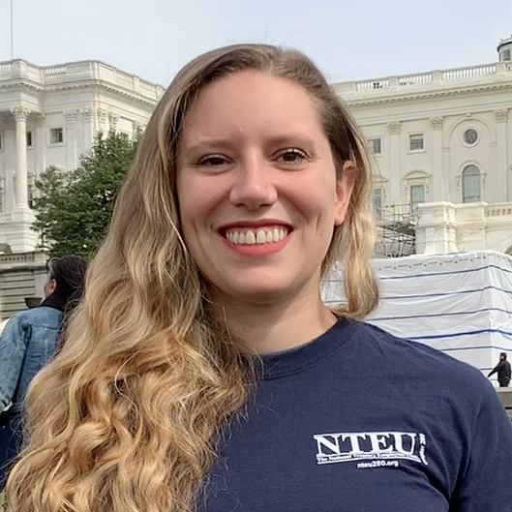

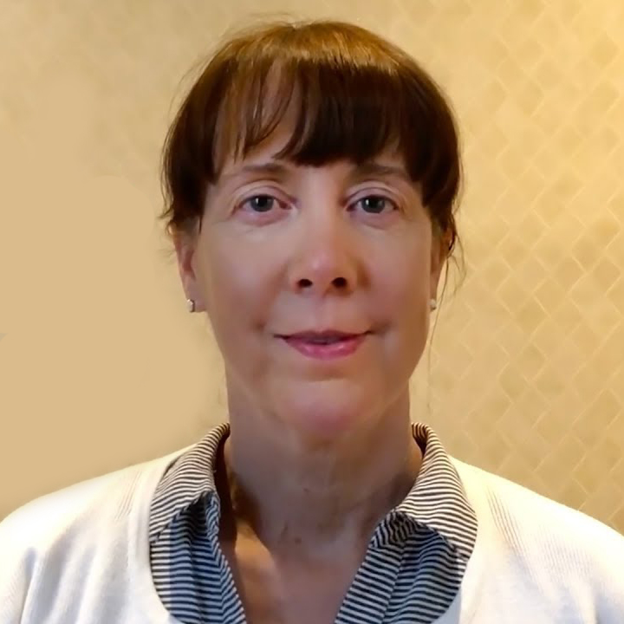


Lawyers
CPAs
Bank Examiners
Law Enforcement Officers
IT Experts
Scientists
Doctors
Researchers
Throughout our
federal government,
NTEU members are:
Notes:
We are lawyers, CPAs, bank examiners, law enforcement officers, IT experts, scientists, doctors and researchers throughout our federal government.

Slide 12

NTEU represents federal employees across
35 agencies and departments.
Notes:
NTEU represents 150,000 federal employees across 33 agencies and departments.
We have a long history of success on behalf of federal workers
We have highly-trained leaders ready to help you

Slide 13

NTEU is guided by our national leaders, elected by union members, who represent you with the media, Congress and federal agencies.
National President Doreen Greenwald spent her federal career at the IRS, where she worked as a revenue officer and served for 14 years as president of NTEU Chapter 1 (IRS Wisconsin).
Doreen Greenwald
National President
Notes:
We are guided by the vision of our national leaders who have years of experience with federal labor relations and are our strongest voices on Capitol Hill.

Slide 14
What exactly does NTEU do?
Notes:
So, what exactly does NTEU do?
For starters, many of the rights and benefits you receive as a federal employee were not handed out by Congress, the White House or any federal agency. They were won by NTEU members—federal employees like you—who fought at the bargaining table, through legislation and by having workplace representation. That hard work—and often difficult wins—are outlined in your contract.

Slide 15
We negotiate the most innovative contracts in the federal government.

Slide 16
Your Contract,
Your Working Life.
Details your defined rights and benefits
on everything from leave to promotions
to work schedules.
It’s the most important document in your working life.
Notes:
Your contract the most important document in your working life. It provides for workplace programs, benefits and protections, and it creates a process for resolving workplace disputes.

Slide 17

Our Work Doesn’t End.
We enforce our contracts.
Notes:
Our work doesn’t end even after bargaining does. At NTEU, we work every day to enforce the terms of our contracts and you can be rest assured that NTEU has your back.

Slide 18

We Advocate for You.
Members of Congress hear from us before making any decisions about your pay, retirement, health insurance, job security and more.
Notes:
We advocate for you on Capitol Hill. We fight for the things you can see in your paycheck and workplace.
Higher pay raises
Paid parental leave
Protections to your health and retirement benefits
We stop bills attacking your pay, workplace rights, retirement and health benefits

Slide 19
We Fight for You.
We win legal battles for you.
Notes:
We win legal battles for you.
Protect and expand federal employee rights
Hundreds of millions in back pay
Higher overtime rates

Slide 20
We Keep You Informed.
NTEU members get the news and information you need to navigate your career.
Notes:
We keep you informed.
Breaking news alerts and our weekly news round-up
Members-only access to NTEU.org
Our monthly NTEU Bulletin newsletter
Legislative action alerts

Slide 21
We Save You Money.
Members get exclusive discounts on insurance, travel, professional services and more.
Notes:
We save you money with members exclusive money-saving discounts on:
Insurance
Travel
professional services
home sale and moving expenses
and more!

Slide 22




We Tell Your Story.
We are the leading voice of federal employees in the media showcasing your work through news releases, social media and public service campaigns.
Notes:
We tell our members’ stories in the media showcasing their work and amplifying their voices through news releases, social media and public service campaigns.

Slide 23

We Win.
NTEU has a proven track record of winning higher pay, securing new workplace benefits, and protecting your retirement.
Notes:
All of NTEU’s effort, for more than 80 years, has been aimed at improving the federal government as an employer and provider of critical public services.

Slide 24
The List Goes On…
Higher pay raises
Paid parental leave
Transit subsidies
Guaranteed back pay in a shutdown
Millions in back pay
Childcare Subsidy Program
Higher overtime rates
Flexible spending accounts
New locality pay areas
FERS sick leave credit
Improvements to the Thrift Savings Plan
Expanding political action
Notes:
These wins give you with higher pay raises, paid parental leave and federal flexible spending accounts. They provided back pay for all federal employees after a government shutdown ends and millions of dollars for employees denied the proper overtime pay. Additionally, our wins include:
Extended coverage for young adult dependents to age 26 on their parents’ health care plans;
Tens of thousands of dollars in retroactive transit subsidies;
Improvements to the Hatch Act, opening-up the political process to federal workers; and
The right of FERS-covered employees to count unused sick leave toward retirement calculations.
These wins help attract the best employees to the federal workforce. They help create viable work environments and provide the American pubic with exceptional service.

Slide 25
We Need You!
Notes:
A strong membership is a strong voice. The more members we have, the more clout we have to protect and build on these gains.

Slide 26
Join NTEU Today!
Together, we are building a stronger future for you, your agency and our country.
NTEU.org/Join
Notes:
Join us in building a stronger future for you, your agency and our country.
Complete an SF-1187 online today! Our one-page form is fully electronic from start to finish and can be completed from your computer, tablet or desktop in just a few minutes.

Slide 27
MISSION: To organize federal employees to work together to ensure that every federal employee is treated with dignity and respect.

Slide 28
National Treasury Employees Union
Presenters:
Name
Name
Name
Notes:
Chapter leaders in your workplace, ready to address issues you may have and enforce your contract.. We are your colleagues, coworkers and first points of contact. We are you chapter officers and stewards. Stewards are highly-trained NTEU leaders in your workplace who make sure management follows the terms
of the contract and treats employees fairly.

