Slide 1
Electronic Questionnaires for Investigation Processing (E-QIP) Instructions and Tips for Internal Revenue Service (IRS) Applicants
Internal Revenue Service IRS HCO PS August 10th, 2023

Slide 2
E-QIP – Before You Start
Before You Start
Identify a time to complete your e-QIP – it can take several hours
Begin as soon as possible. Do not wait until the last minute. Your tentative offer may be rescinded if all required materials are not received by the deadline stated in your email.
Gather information needed to cover the period requested:
Citizenship and identifying information for you, your spouse, and immediate relatives
Full names, complete physical addresses, and phone numbers of individuals who can verify your recent residency history, education and employment history
Previous residency (home) addresses
Education history – dates, diplomas/degree(s) awarded, and institution addresses
Employment history – including supervisor name and contact information

Slide 3
E-QIP Registration – Step 1
E-QIP Registration
Step 1
Open the e-QIP applicant website located at https://www.dcsa.mil/is/eqip/ Click "Enter e-QIP"

Slide 4
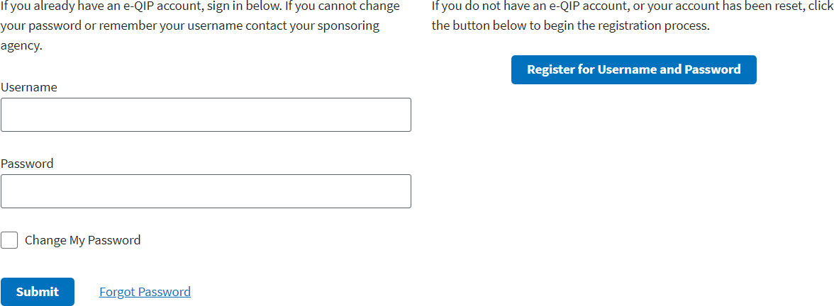
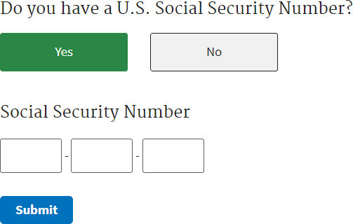
E-QIP Registration – Step 2 and 3
E-QIP Registration
Step 2
Click the “Register for Username and Password” button
Step 3
Enter your SSN and click submit

Slide 5
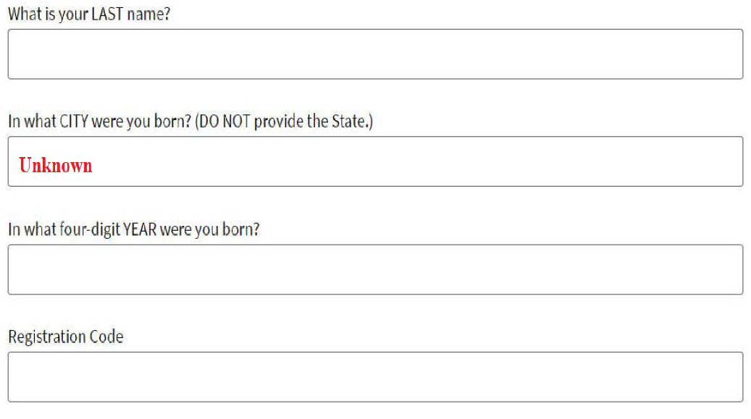
E-QIP Registration – Step 4
E-QIP Registration
Step 4
Answer the 3 Golden Questions and
Enter the 14-digit Registration Code (provided in email from e-QIP)
Type your Last name, this is Case Sensitive
Type your city of birth, this is Case Sensitive
Type the Year you were born
Type the Registration Code, this is Case Sensitive
Do not cut and paste the Registration Code, please type it in.
Contact the e-QIP help desk if you did not receive a registration code or if you are unable to register. (this information is provided on slide 24)

Slide 6
E-QIP Helpful Tips and Definitions
Helpful Tips and Definitions
Read the instructions thoroughly and carefully
You must complete all sections and answer all questions completely and truthfully
Dates - Ensure all dates follow prescribed formats (example: mm/dd/yyyy)
Avoid responses of “I do not know”, “Unknown”, or “Not Applicable”. If you do not know the requested information, select the “Optional Comment” button and provide a detailed explanation
Provide complete physical addresses (P.O. boxes are not allowed), document numbers and full names where requested
Do not use the browser’s forward or back buttons or the system may log you out as a security precaution
Select “Save” after each data entry to protect against lost data

Slide 7
E-QIP Additional Helpful Tips and Definitions
Helpful Tips and Definitions
You are required to provide full names and contact information for individuals who can verify the information you have provided throughout the e-QIP. They are referred to as “verifiers”
Do not use an individual as a “verifier” more than once
“Verifiers” may be friends, neighbors, co-workers, roommates, landlords, etc. and must be able to verify your residency history, education and employment activity
“Verifiers” must:
Be a specific person (Listing an office or agency is not acceptable)
Currently live in the United States
Be readily available for contact
Have complete contact information (address, phone number and email address)

Slide 8
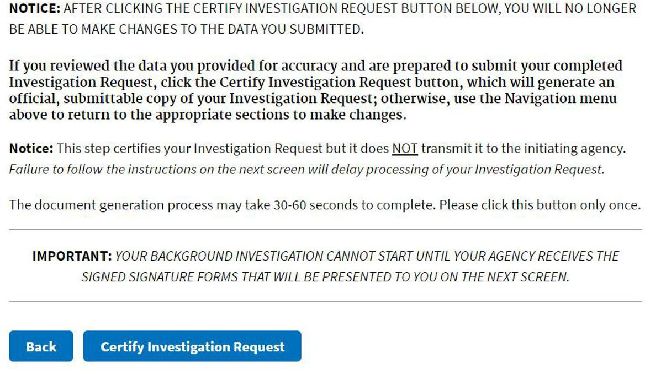
E-QIP Registration Certification
Certify and Save Your e-QIP
Certify your e-QIP by selecting the “Certify Investigation Request” button
Note: Save a copy of your e-QIP after certifying from the Archival Copy section. You will not be able to access after you release it.

Slide 9
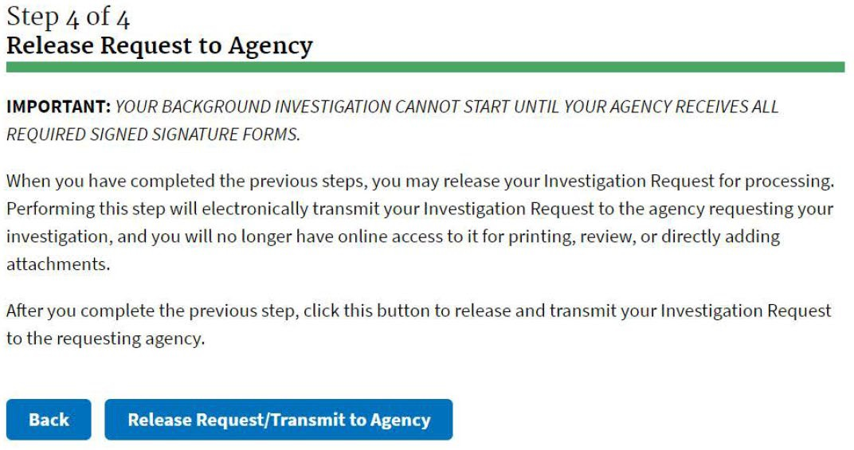
E-QIP Release/Request Transmit to Agency
Certify your e-QIP by selecting the “Certify Investigation Request” button
Review and digitally sign signature forms that appear in e-QIP
Select “Release Request/Transmit to Agency” to submit your e-QIP

Slide 10
E-QIP Instructions and Tips for IRS Applicants
Assistance
We are here and ready to support you on your hiring journey!
HCO Applicant e-QIP help desk 1-855-559-2259
HCO Applicant e-QIP email- hco.ps.applicant.eqip@irs.gov

