Slide 1
USA Staffing Benefits User Guide
HR Shared Services
Electing/Waiving FEHB and FEGLI
Notes:
Good morning, everyone. My name is Caroline, and I am Rebeca and we are with the Benefits Team. We are here to review Health Benefit and Life Insurance Elections. If you do have questions or need a clarification. We do have Debbie/Cindy here with us today who will be keeping an eye on the chat box.
At the end of the presentation, we will have a short Q&A session only on health and life insurance elections.
Lets get started.
USA Staffing Benefits User Guide
Slide 1:
Presenter 2: Cough cough cough
Presenter 1: oh wow Rebeca are you okay:
Presenter 2: No, I am sooo sick.
Presenter 1: It sounds like you need INSURANCE!!!!
Presenter 1: Welcome NEW HIRES today we are going to talk about BEN -E -FITS. What are your options, how can you enroll, and so much more.
You will be using your USA Staffing Portal to enroll in Health and Life insurance.

Slide 2
The information in this presentation is meant to help new employees navigate the USA Staffing system to complete any Benefits tasks they may be assigned.
Notes:
Presenter 2: The information in this presentation is meant to help new employees navigate the USA Staffing System to complete any Benefits tasks they may be assigned.
Presenter 1: The tasks in the examples might not be an exact match for every employee, however the general steps to complete the tasks should be the same.

Slide 3
USA Staffing Help Center
When logged in to USA Staffing, a Help Center link appears at the top left of the screen. When selected, screenshots appear to assist employees with navigating each task.
Screenshot IRS Careers page. Red arrow points to Help Center link, third option from left on navigation bar.
Notes:
Presenter 2: Before we dig into the meat and potatoes. Remember once you are logged into the system there is a Help Center link at the top left of the screen.
Presenter 1: When you click on this link screen shots appear to help navigating each task.

Slide 4
Employees should receive an email from USA Staffing when their Benefits forms have been assigned.
Screenshot of an email reads: New Hire Additional Tasks Assigned
usastaffingoffice@opm.gov 12:20 PM
Το: Retention Policy Retain for 20 years (20 years) Expires 12/6/2041
Dear
You have been assigned additional tasks as part of your onboarding process with Department of Treasury. Please access your USA Staffing® onboarding record by navigating to https://onboard.stage.usastaffing.gov and login with your USAJOBS login credentials. You will find information about the additional tasks on the Tasks page.
If you have any questions, please contact your HR Office.
Thank You!
USA Staffing®
Notes:
Presenter 2: Once you have access to your email. Be on the look out for an email from USA Staffing.
Presenter 1: This means your Health and Life insurance forms have been assigned and can be filled out.
Presenter 1: Rebeca this means you are one step closer at getting that cold taken care of.

Slide 5
Log in using the link from the email, and access the Questionnaire to complete the new question items that have been assigned. All sections with new requirements will be marked with a red square to the left.
Screenshot IRS Careers, Tasks page. Incomplete required tasks are highlighted, red arrow points to incomplete required tasks’ red checkboxes.
Notes:
Presenter 2: That sounds great what would be my next step.
Presenter 1: To log into USA Staffing click on the link in your email. This will give you access to the Insurance Questionnaires. All sections with new requirements will be marked with a red square letting you know this needs attention. It will turn green when it is complete. It is important to verify your Benefits answers prior to signing and submitting your forms.
Presenter 2: You would never guess how many employees accidently forget to enter their spouse’s birthday
Presenter 1: Yikes. That would be embarrassing.

Slide 6
The Benefits Information Questionnaire contains information and questions related to the employee’s Federally-offered benefits.
A diagram. A pensive figure stands in between two opposing arrows. An arrow on the left points right, is labeled with FEHB Federal Employees health benefits Program logo. The arrow on the right points left, is labeled with FEGLI Federal Employees Group Life Insurance logo.
Notes:
Presenter 2: There are questionnaires in relation to both Federal Employees Health Benefits Program (FEHB) and Federal Employees Group Life Insurance (FEGLI).
Presenter 1: Pages contained within this Questionnaire may vary based on information needed by the hiring agency during the onboarding process.

Slide 7
Benefits Information Questionnaire
Select the Benefits Information Questionnaire to answer and review all questions in those sections. Verify accuracy of the responses. Save and continue at the bottom of each section when completed. Select ‘continue’ to return to the Questionnaire item list to begin the next section.
Screenshot Benefits Information Questionnaire, arrow points to continue button right of the Questionnaires to complete.
Notes:
Presenter 1: Select “Complete New Hire Questionnaire” next you will select Benefits Information. Then you will be able to answer and review all questions in those sections.
Presenter 2: Verify the accuracy of your responses. Think of it as extra practice to make sure you remember your spouse’s birthday. All jokes aside. Once the questionnaire is completed there is a save and continue at the bottom of each section. Select continue to return to the Questionnaire item list to start the new section.

Slide 8
FEDERAL EMPLOYEES HEALTH BENEFITS
The Health Insurance page contains questions related to the employee’s Federal Employees Health Benefits (FEHB) elections.
Notes:
Presenter 2: Ah, what I’ve been waiting for cough cough.. Health Insurance.
Presenter 1: That is right! The Health Insurance page contains questions related to the employee’s Federal Employees Health Benefits
(FEHB). Remember you can go to www.OPM.gov to review Insurance provider options.
Presenter 2: New hires if you want to enroll for Federal Employee Health Benefits. I’d recommend you write down that web address. Again, it is www.opm.gov.

Slide 9
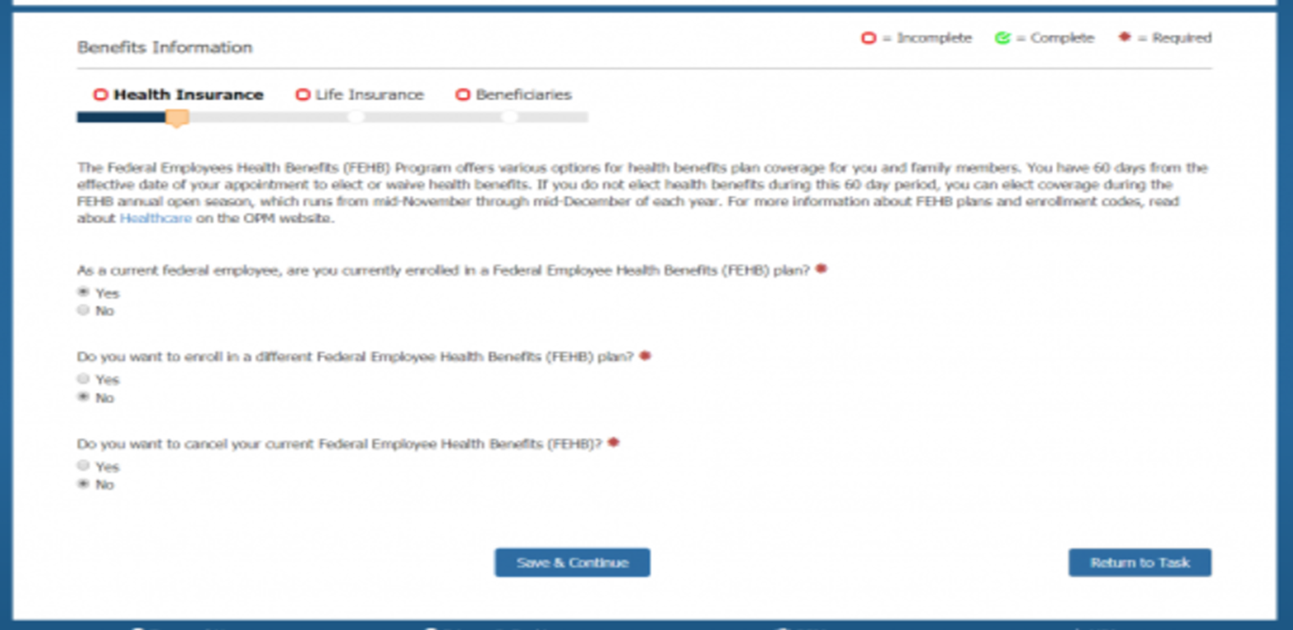
Benefits Information 1
Notes:
Presenter 1: Rebeca as a current federal employee, are you currently enrolled in a Federal Health Benefit Plan?
Presenter 2: My spouse used to but started working to the private sector. To answer your question. No.
Presenter 1 Do you want to enroll in a Federal Employee Health Benefits?
Presenter 2: Yes, please this cold is killing me!
Presenter 1: There are just some of the examples of questions you will have to answer on your questionnaire.

Slide 10
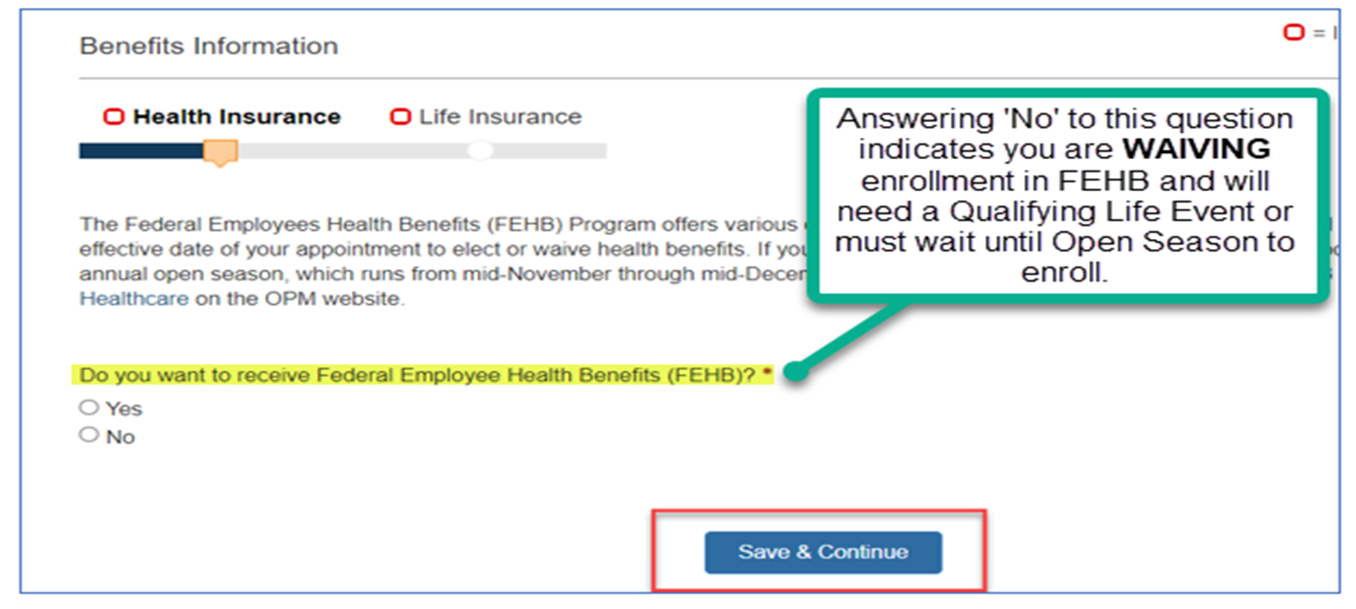
Benefits Information 2
Notes:
Presenter 2: Caroline what would happen if I decided to answer NO to the question on the screen?
Presenter 1: You would have chosen to waive your Federal Employee Health Benefits. This means you would need to wait until a Qualifying life event, or Open season to enroll.
Presenter 2: Well, what is a qualifying life event?
Presenter 1: A Qualifying Life Event or QLE is when you experience one of the following: Marriage, Divorce, Birth of a baby, Death, Last eligible child turns 26, Adding a Foster child, or adopting a child.
Presenter 2: I definitely want to enroll. I better pay close attention to what I select.

Slide 11
If health benefits are waived, the employee will need to wait until the annual FEHB Open Season or experience a Qualifying Life Event (QLE) to enroll.
Notes:
Presenter 1: Yes, always read and double check. Once you are enrolled Waived or not, you will have to WAIT until Open Season, or you experience a Qualifying Life Event.

Slide 12
Family Member Eligibility 1
When electing self-plus-one or self and family FEHB coverage, employees must review the SF2809 instructions carefully to ensure only eligible family members are listed on the plan.
A diagram titled: Family Member Eligibility Circle. An illustrated family at center of diagram. Five sections surround the center reading as follows clockwise:
Child: (Under age 26); Biological Child; Stepchild; Married Child (excluding their spouse and kid).
Adopted Child: (Under age 26); Placed for adoption; Financial responsibility exists.
Foster Child: (Under age 26); Parent-child relationship exists; Common residence; Expect to raise the child to adulthood; Primary source of financial support.
Spouse: Legally married; Initiated in a State that recognizes common law marriages.
Child incapable of self-support: (Age 28 or older); Incapable of self- support because of a physical or mental disability that existed before age 26 and will last for at least a year.
Notes:
Presenter 2: What do I need to do to add my daughter and spouse on the insurance?
Presenter 1: Great question! Make sure to review the SF2809 Health Benefits Election Form instructions. There are different codes for different family member types, and it is important to review page 2 of the SF2809 instructions because of this.
For example, the family member types are Spouse 01, Child under 26 - 19, and Foster Child 10.
Presenter 2: I’ll have to let my spouse know he is not (Double O Seven) 007.
Presenter 1: Good One.

Slide 13
Family Member Eligibility 2
Documents must be provided for each family member listed on the SF2809 to verify eligibility.
Information regarding acceptable documents can be found at: www.opm.gov/healthcare-insurance/healthcare/eligibility
Notes:
Presenter 2: Will I need to turn in anything to show my family is… my family?
Presenter 1: Yes, each family member needs to be verified. A list of acceptable documents can be found at. www.opm.gov/healthcare-insurance/healthcare/eligibility

Slide 14
Family Member Eligibility 3
If benefits are elected for family members, the Benefits office will add additional tasks requiring an upload of supporting documents to verify family member eligibility.
Employees should monitor their email for notification of additional tasks and instructions on uploading the documents.
If the required documentation is not provided within 60 days, non-verified family members will be removed from the coverage.
Notes:
Presenter 1: If benefits are elected for family members, the Benefits office will add additional tasks requiring an upload of supporting documents to verify family member eligibility. Another thing you should do is monitor your email for a notification of additional tasks and instructions on uploading documents.
Presenter 1: It is important to know. If the required documentation is not provided within 60 days, any family members not verified will be removed from the coverage, retroactive to the effective date.
Presenter 2: Wait wait wait. Let me get this straight. If I do not provide the correct documentation in 60 days from when I am notified, my dependents will be removed from the coverage?
Presenter 1: That is right. So, if you take your daughter to the doctor and do not send in the documentation within 60 days. You will have to pay all those fees back, because she would not have been covered at that time.
Presenter 2: I will be sure to get those documents in right away.

Slide 15
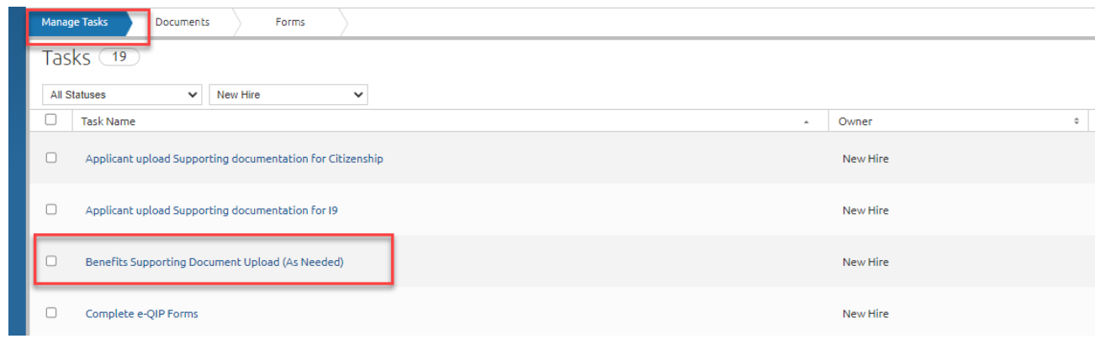
UPLOADING VERIFICATION DOCUMENTS
Notes:
Presenter 2: How would I upload those documents?
Presenter 1: On the manage tasks tab, select “Benefits Supporting Document Upload (as needed)”. You will then be able to upload the documentation. Also, expect an email from a member of the benefits team. They will send a notification asking for the family verification documents. If you do not have the Benefit Supporting tab loaded on your profile, you can also submit your documentation to the Ogden Benefits Inbox at Ogden.Benefits.Section@irs.gov . Debbie/Cindy would you please add that email address to the chat. Thank you.

Slide 16
FEHB EFFECTIVE DATE
FEHB coverage becomes effective on the first day of the pay period following receipt of the completed Health Insurance Questionnaire, and that follows a pay period during any part of which the employee was in a pay status.
NOTE: Benefits do not become effective upon receipt of form.
Allow up to four weeks for processing.
Notes:
Presenter 2: Once I submit all the documentation when can I use my insurance?
Presenter 1: Your effective date is the first day of the pay period following the receipt of a Valid form. You will need to allow up to 4 weeks for processing.
Presenter 2: What do you mean by Valid?
Presenter 1: If your form is missing any information, the benefits team will reach out to inform you of any inconsistencies and how you can send in a new form.

Slide 17
FEDERAL EMPLOYEES GROUP LIFE INSURANCE
The Life Insurance page contains questions related to the employee’s Federal Employees Group Life Insurance (FEGLI) elections.
Notes:
Presenter 2: Caroline? Do Transformers buy life insurance or Car insurance?
Presenter 1: Ha ha is everyone awake? It’s time to talk about Life Insurance. We are going to dive into the Federal Employees Group Life Insurance (FEGLI) elections.

Slide 18
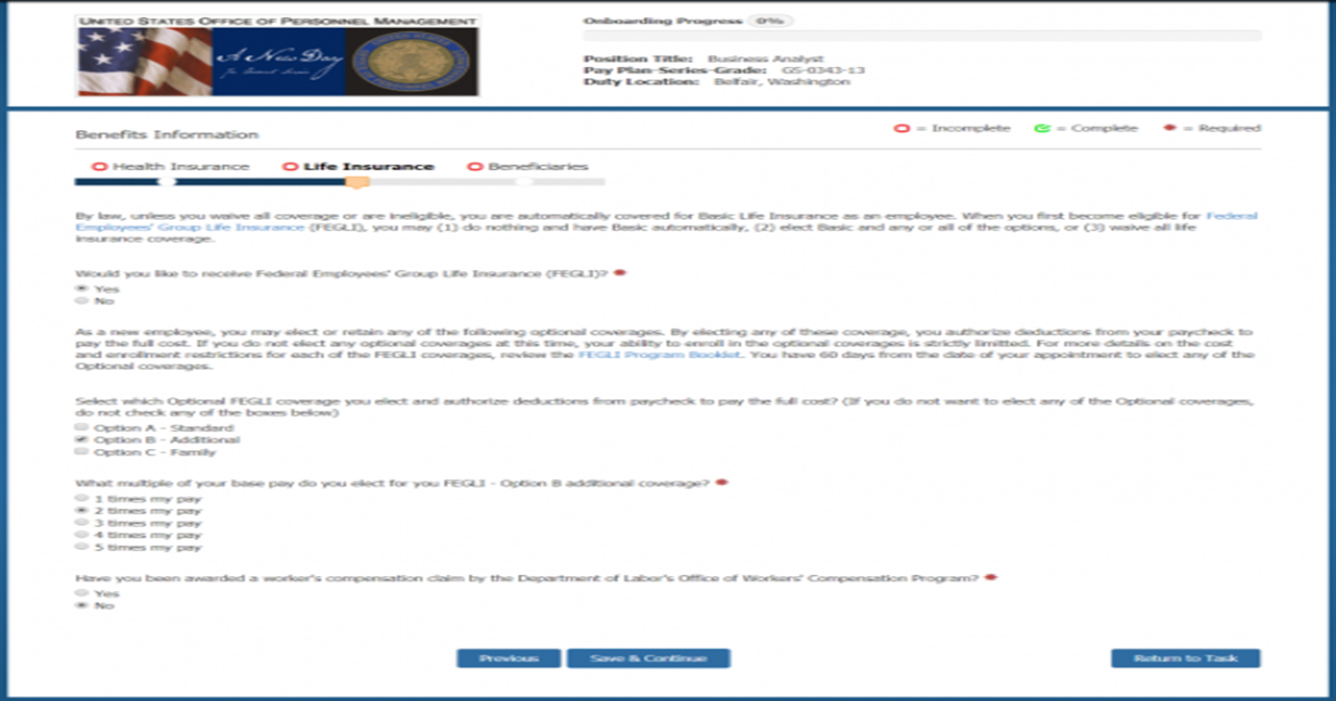
Benefits Information 3
Notes:
Presenter 2: As you will see on this slide, you will need to fill out the questionnaire for the Life insurance.

Slide 19
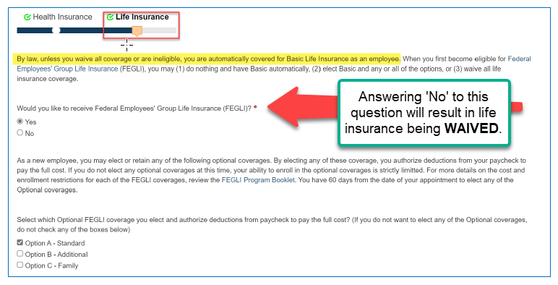
Benefits Information 4
Notes:
Presenter 2: Be sure to read through everything. Hey Caroline, are you interested in FEGLI.
Presenter 1: No I am not.. What is that?
Presenter 2: I thought you wanted life insurance coverage? If you say no on the questionnaire your Life Insurance will be waived.
Presenter 1: I Oh wow I can see why it is important to double check my answers.

Slide 20
FEGLI BASIC and Optional Coverage
To elect anything other than Basic or to waive life insurance, a form must be submitted.
The Firm Job Offer letter explains: “You will be automatically enrolled in Basic life insurance coverage on your first day in pay and duty status following the date you became eligible. If you choose to elect Optional life insurance you must complete the life insurance enrollment questionnaire within 60 days of your start date. If you do not elect Optional life insurance within the established timeframe, you will continue with Basic coverage only. You must sign and date for the Basic life insurance coverage in order to elect Optional coverage.”
Optional coverage becomes effective the day a valid form is received, provided the pay and duty requirements are met.
If an employee elects to waive FEGLI, the change will become effective the end of the pay period in which the SF2817 is submitted.
Notes:
Presenter 2: If you want anything other than Basic, or don’t want life insurance at all you have to submit a SF2817 Life insurance form in USA Staffing.
Presenter 1: So if I only want Basic I just… do nothing.
Presenter 2: That is correct, however some positions are excluded by law or regulation. So, Only if you are eligible when you are hired you are automatically enrolled in Basic coverage on your first day in pay and duty status following the date you became eligible.
If you choose to elect optional life insurance, you must complete the enrollment questionnaire within 60 days of your start date.
You must sign and date for the Basic life insurance coverage to elect Optional Coverage.
Optional coverage becomes effective the day a valid form is received as long as you meet pay and duty status.
Presenter 1: What is the effective date if I Waive coverage?
Presenter 2: The effective date will be the end of they pay period in which the form is submitted. Unless it is submitted the same pay period as your Enter on Duty Date. Then it would be well, the day you entered on duty.

Slide 21
Federal Employees Group Life Insurance (FEGLI)
Federal Employees’ Group Life Insurance (FEGLI) Life Insurance. FEGLI can help you protect your loved ones from burdensome funeral costs and catastrophic loss of your income if you die unexpectedly.
A table, two columns four rows.
BASIC: Amount of Coverage, Your annual salary rounded up to the next $1,000, plus $2,000; Who Is Covered?, You; Cost each biweekly pay period, 15¢ per $1,000 of coverage (Free for postal employees); Cost Increases with age?, No; Newly eligible employees automatically enrolled?, Yes, unless you waive coverage.
OPTION A: Amount of Coverage, $10,000; Who Is Covered?, You; Cost each biweekly pay period, Starting at 20¢; Cost Increases with age?, Yes; Newly eligible employees automatically enrolled?, No, you must elect this coverage.
OPTION B: Amount of Coverage, 1, 2, 3, 4, or 5 multiples of your salary rounded up to the next $1,000; Who Is Covered?, You; Cost each biweekly pay period, Starting at 2¢ per $1,000 of coverage; Cost Increases with age?, Yes; Newly eligible employees automatically enrolled?, No, you must elect this coverage.
OPTION C: Amount of Coverage: 1, 2, 3, 4, or 5 multiples. Each multiple equals $5,000 for the life of your spouse and $2,500 for the life of each eligible child; Who Is Covered?, Your spouse and unmarried dependent children under age 22; Cost each biweekly pay period, Starting at 22c per multiple; Cost Increases with age?, Yes; Newly eligible employees automatically enrolled?, No, you must elect this coverage.
Notes:
Presenter 1: Well, what does Basic and Optional mean?
Presenter 2:
Basic: will only cover you in the amount of your annual salary rounded up to the next thousand plus two thousand more.
Option A: Will only cover you but add an additional Ten thousand to your basic.
Option B: Will only cover you but add 1,2,3,4, or 5 multiples of your salary rounded up to the next Thousand.
Option C: Will cover your spouse and unmarried dependent children under age 22. This can add 1,2,3,4, or 5 multiples. Each multiple equals Five thousand for the life of your spouse, and Two thousand Five Hundred for the life of each eligible child.
Presenter 1: I see so Federal Employee Group Life Insurance is meant to protect your loved ones from catastrophic loss of income if you die unexpectedly.
Presenter 2: That is correct. I know its hard to talk about, but if you plan ahead, you can be prepared for any situation.

Slide 22
Benefits Information 5
If an employee erroneously waives their life insurance, they can submit another election within the 60-day Initial Opportunity period . If the erroneous waiver of FEGLI coverage is canceled (enrolling the employee retroactively in BASIC coverage), the employee will be responsible for any missed FEGLI premiums. If Optional coverage is also elected, it will have a prospective effective date, based upon the employee’s pay and duty status.
Otherwise, if life insurance is waived, the employee will need to experience a QLE to enroll in Basic and Optional coverage (including Option C – Family), or after one year from the effective date of the waiver, can provide medical information to enroll in Basic, Option A or Option B coverage only.
FEGLI Open Seasons are infrequent and rare.
Information on benefits can be found at the following website: http://jobs.irs.gov/resources/benefits
Notes:
Presenter 1: Oh my… I selected no and accidently waived my coverage. Could I change my enrollment if I waived it on accident?
Presenter 2: Yes, as long as it was done in error, and you are with in your 60 days from Enter on Duty date. Past that you will need a valid Qualifying life event or wait until Open Season for Life Insurance.
Presenter 1: When is Open Season?
Presenter: Those Open Seasons are infrequent and rare. The last one was in 2016.

Slide 23
Benefits Information 6
Prior to signing the forms, verify the answers to the Questionnaire task previously completed for accuracy.
Notes:
Presenter 2: So, remember prior to signing your forms, verify the Questionnaire for accuracy.

Slide 24
Benefits Information Changes 1
If changes need to be made to any data displayed on a form, return to the appropriate questionnaire and modify the response to the question(s) used to populate the form. Select ‘Close’ at any time to return to the previous screen. Once the form has been reviewed, select ‘Confirm’ to be taken to the next screen to ‘Sign and Submit’ to return the form
to Human Resources.
Notes:
Presenter 1: How would I make changes to any errors?
Presenter 2: If changes need to be made to any data displayed on a form, return to the appropriate questionnaire, and modify the response to the question(s) used to populate the form.
Select ‘Close’ at any time to return to the previous screen.
Once the form has been reviewed,
select ‘Confirm’ to be taken to the next screen to ‘Sign and Submit’ to return the form
to Human Resources.

Slide 25
Benefits Information Changes 2
Changes can be made to forms up until they are signed.
Notes:
Presenter 1: I think I got it. If I don’t sign the form. I can make changes. So, make sure everything is correct before signing.
Presenter 2: That is correct.

Slide 26
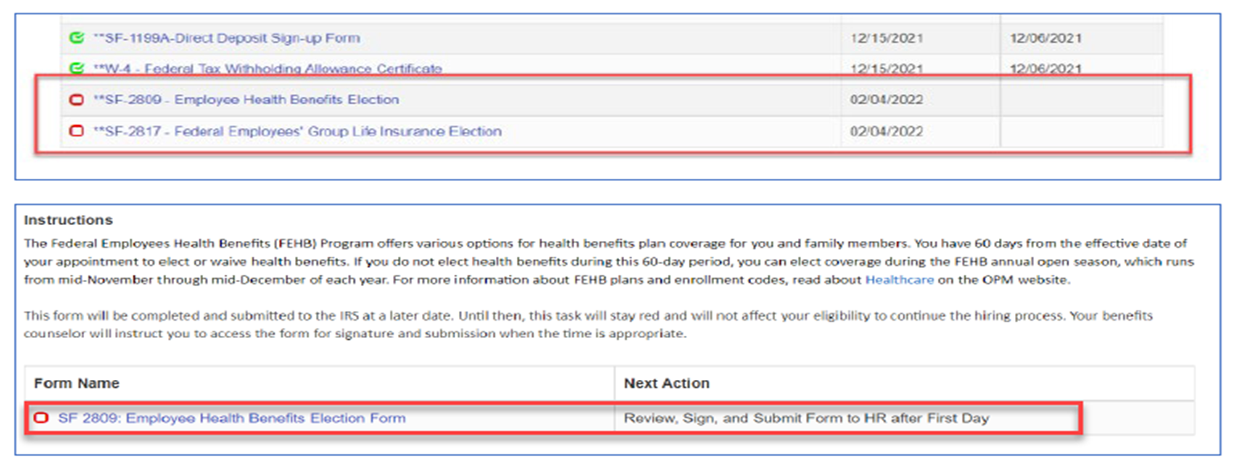
Benefits Information 7
Once all Questionnaire items are complete, select the ‘Close’ button at the bottom of the page to be returned to the task list to sign and submit the Benefits forms. Select the hyperlink for each form to be signed, then again in the new window that appears.
Notes:
Presenter 2: Once all the questionnaire items are complete all you need to do is select the ‘Close’ button at the bottom of the page. This will return you to the task list to sign and submit the Benefits forms. You will need to select the hyper link for each form to be signed, then again in the new window that appears.

Slide 27
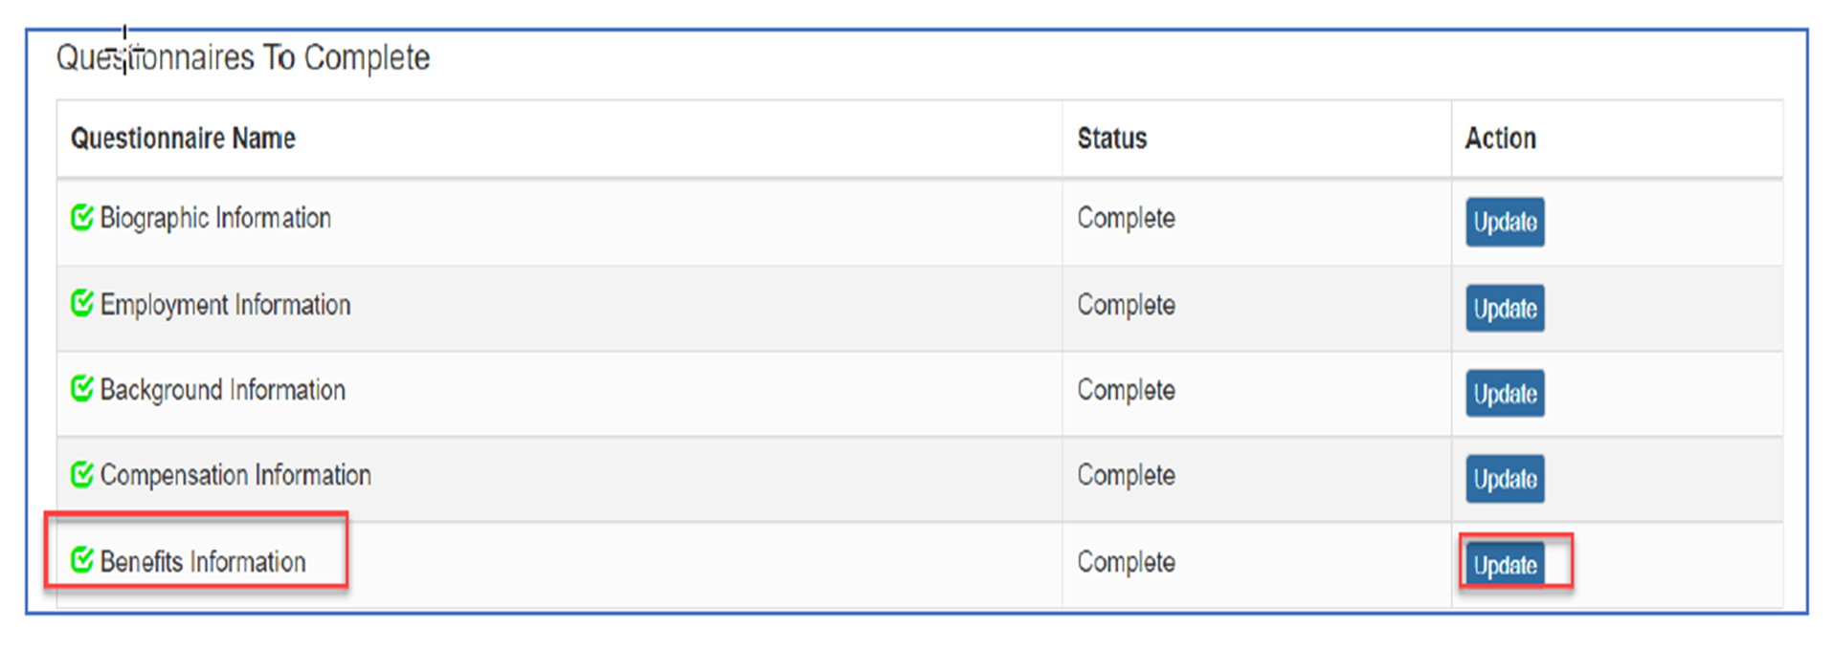
Benefits Information 8
Notes:
Presenter 1: (In best flight attendant voice) Ladies and Gentlemen if you take a look at your computer monitor you will see a screen shot of a list of Questionnaires to complete. Towards the bottom you will see the Benefits Information Link and the update button.

Slide 28
Benefits Information 9
Employees must submit finalized FEHB and FEGLI forms, not just answer the Questionnaire.
Failure to do so within the 60-day timeframe
will result in waived health benefits and default to enrollment in Basic life insurance coverage.
Notes:
Presenter 2: Glad we caught your attention. Please note Employees must submit finalized Health Insurance and Life Insurance Forms. Not just answer the questionnaires.
Presenter 1: Failure to sign and submit within the 60-day time frame will waive your health benefits, and default enrollment in Basic for life insurance coverage.

Slide 29
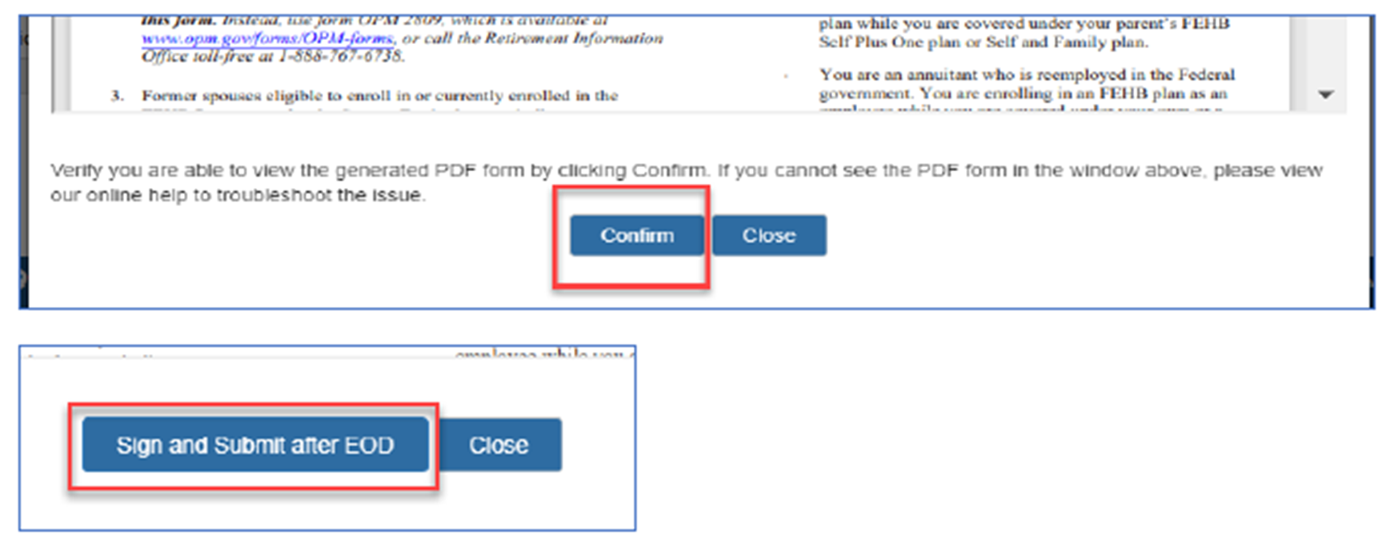
Submit Benefits Information 1
Review the forms for accuracy, then select the ‘Confirm’ button. Then select the ‘Sign and Submit after EOD’ button.
Notes:
Presenter 1: Once you review your forms for accuracy you will then select the Confirm button, then select sign and submit after EOD button.
Presenter 2: The information will then be sent to the Benefits Team for processing.

Slide 30
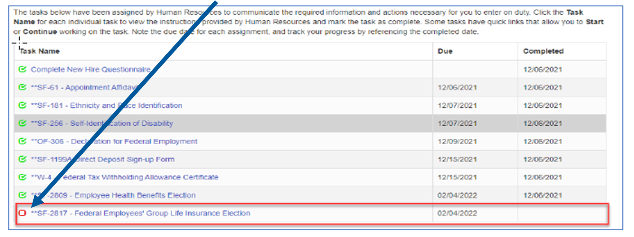
Submit Benefits Information 2
Follow the same process to sign and submit any remaining forms indicated by a red square.
Notes:
Presenter 2: If you see a red square this means you are not done yet! Please sign and submit any remaining forms.

Slide 31
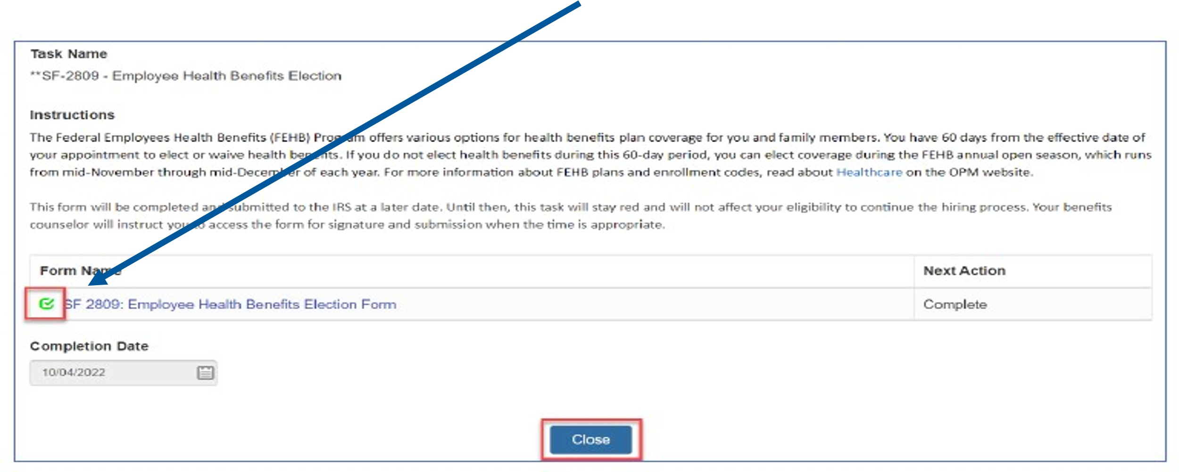
Submit Benefits Information 3
Once the form reflects the green checkmark select the ‘Close’ button to return to the task list.
Notes:
Presenter 1: Once the box is green you can select the close button.

Slide 32
Submit Benefits Information 4
Failure to return to the task list and sign the benefits forms will result in the forms being deemed incomplete and not sent to the servicing personnel office for processing.
Notes:
Presenter 2: Failure to return to the task list and sign the forms means the forms will be deemed incomplete and not sent to the servicing personnel office for processing.

Slide 33
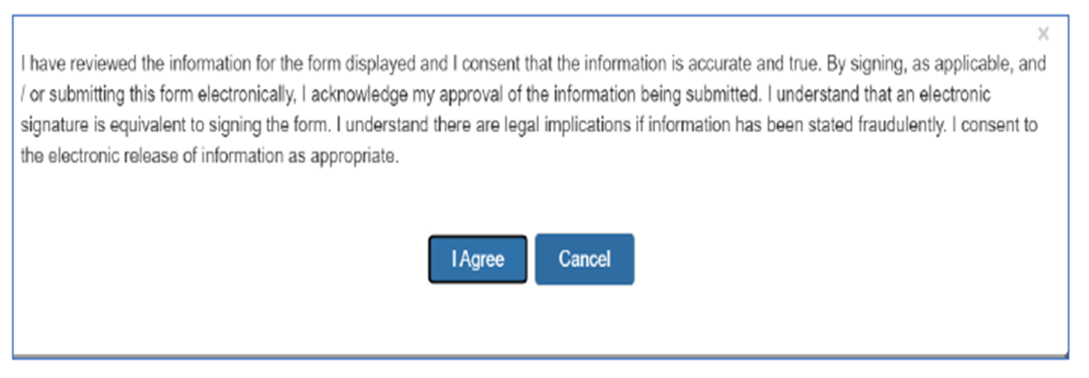
Submit Benefits Information 5
Notes:
Presenter 1: An “I agree” box will pop up saying you reviewed the information and acknowledge your approval of the information being submitted.

Slide 34
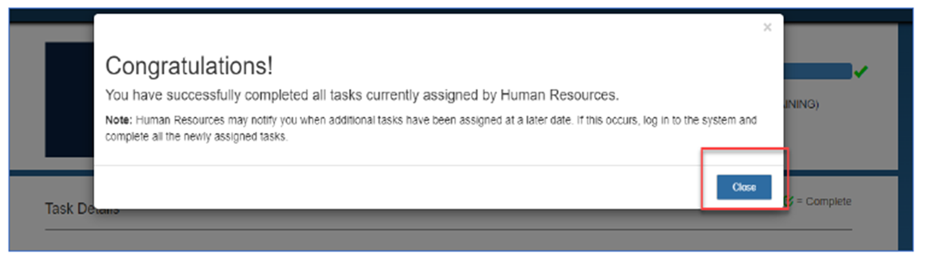
Submit Benefits Information 6
Once all tasks have been completed, the ‘Congratulations’ popup will appear and the progress bar should be at 100%.
Notes:
Presenter 2: Once all tasks have been completed a CONGRATULATIONS will appear!
Presenter 1: The information will be sent to the Benefits team for review. If the form is incorrect the Benefits team will contact you … so keep an eye on your inbox.!

Slide 35

Benefits Information 10
Notes:
Presenter 1: Wait.. Is that it
Presenter 2: That is all, you have survived. Go on and select your benefits!!
Presenter 1:HOLD UP!!!!! I just transferred from another area… I thought my benefits would roll over. Would I need to fill out the 2817 and 2809?
Presenter 2: Great question lets dive into that!

Slide 36
-You DO NOT need to fill out the 2809 & 2817.
-Send last E&L to Ogden.benefits.section@irs.gov
Transferring from another Agency?
Not Eligible at Prior Agency
-If our HR has indicated you are now Eligible
-Fill out the 2817 & 2809
Previously Enrolled at Prior Agency
-Send in your E&L statement to Ogden.Benefits.Section@IRS.gov
Vison and Dental
Contact BeneFeds directly at 1-877-888-3337 or www.BeneFeds.com
Notes:
Presenter 2: If you were not eligible for Health or Life insurance at your prior agency, and the HR staff with the IRS has indicated you are now eligible. PLEASE PLEASE send in the 2817 & 2809 so we can set you up.
Presenter 1: I was already enrolled so what do I do?
Presenter 2: The Benefits team is alerted when Employee transfer from another agency. A SF75 Information is sent to the benefits team to process. The Benefits Team does not always receive the SF75 so if you want to expedite the process send in your last Earning and Leave Statement to Ogden.benefits.section@IRS.gov
Presenter 1: What about Vision & Dental?
Presenter 2:We do not process vision and dental you will need to contact BeneFeds directly at 1-877-888-3337 or go to BeneFeds.Com
Presenter 1: Gee Wiz Thank You!
Presenter 2: We will now open the floor to Question and Answers only pertaining to Health and Life Insurance. Please raise your hand and we will call on you.

Slide 37
FAQs and Helpful Links:
ERC (Employee Resource Center) : 866-743-5748
Ogden Benefits Box: Ogden.Benefits.Section@irs.gov
Ogden Fax: 855-816-9805
OPM: www.opm.gov
Healthcare Plan Information 2023: Healthcare : Plan Information - OPM.gov
Healthcare Premiums: https://www.opm.gov/healthcare-insurance/healthcare/plan-information/premiums/
Benefeds: www.Benefeds.com
Current 2817: https://www.opm.gov/forms/pdf_fill/sf2817.pdf
Current 2809: https://www.opm.gov/forms/pdf_fill/sf2809.pdf
Health Benefits start the first day of the pay period after we receive a processible form.
You have 60 days from your Enter on Duty Date to make a FEGLI and FEHB selection.
Please allow up to 4 weeks for the processing of your forms.

